Slide 1
Design and Analysis of Algorithms
CS602
Lecture 17
Network Flow – II

Slide 2
A quick recap from the last lecture

Slide 3

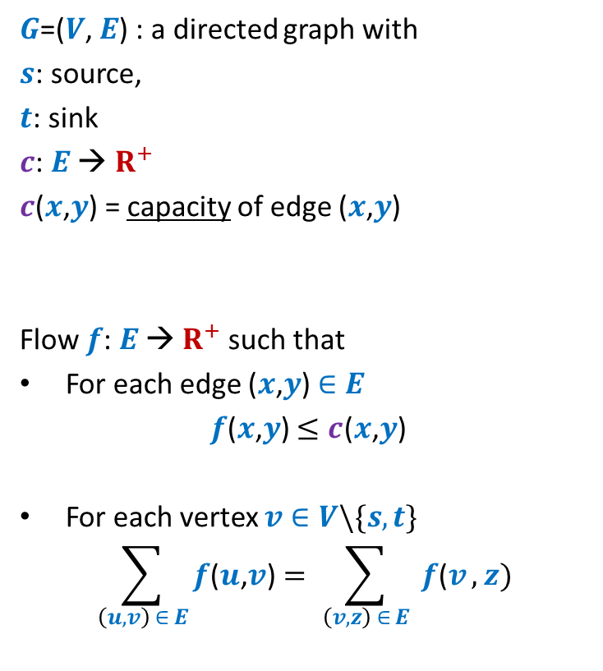





Formal Description of Flow
2
$G$=($V$, $E$) : a directed graph with
$s$: source,
$t$: sink
$c$: $E$ → $R^{+}$
$c$($x$,$y$) = capacity of edge ($x$,$y$)
Flow $f$: $E$ → $R^{+}$ such that
For each edge ($x$,$y$) $∈E$
$f$($x$,$y$) $≤c$($x$,$y$)
For each vertex $v∈V\backslash \{s,t\}$
$$\sum_{\left(u,v\right) ∈ E}{f\text{(}u\text{,}v\text{)}}=\sum_{ \left(v,z\right) ∈ E }{f\text{(}v},z)$$
$$v$$
$$x$$
5
6
15
8
$$t$$
$$s$$
6
7
14
7
17
$$u$$
4
$$y$$
Capacity constraint
Conservation constraint

Slide 4

Formal Description of Flow
2
$\text{value}\text{(}f\text{)=}$ flow leaving $s$
$$=\sum_{\left(s,v\right) ∈ E}{f\text{(}u\text{,}v\text{)}}$$
$G$=($V$, $E$) : a directed graph with
$s$: source,
$t$: sink
$c$: $E$ → $R^{+}$
$c$($x$,$y$) = capacity of edge ($x$,$y$)
Flow $f$: $E$ → $R^{+}$ such that
For each edge ($x$,$y$) $∈E$
$f$($x$,$y$) $≤c$($x$,$y$)
For each vertex $v∈V\backslash \{s,t\}$
$$\sum_{\left(u,v\right) ∈ E}{f\text{(}u\text{,}v\text{)}}=\sum_{ \left(v,z\right) ∈ E }{f\text{(}v},z)$$
$$v$$
$$x$$
4
5
5
11
6
1
15
8
$$t$$
$$s$$
6
7
1
7
7
14
7
17
$$u$$
4
$$y$$

Slide 5
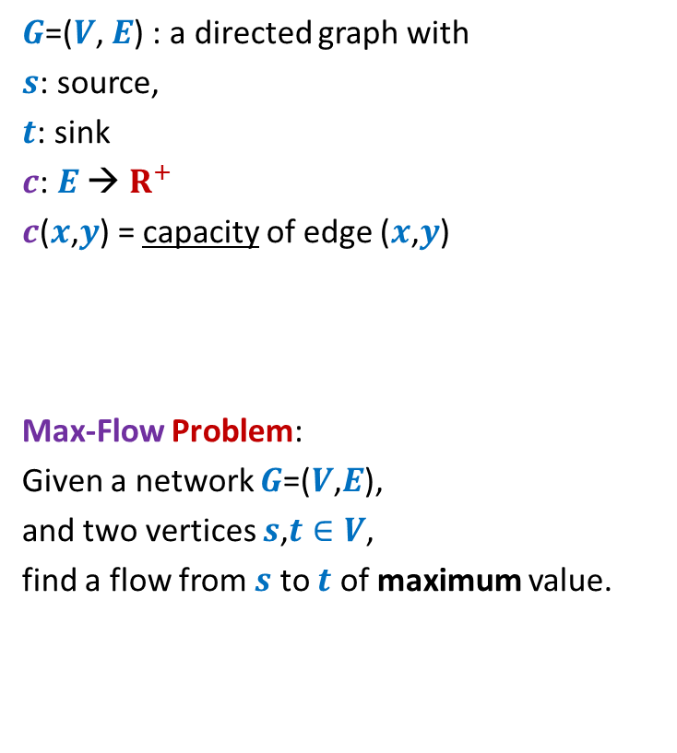
Formal Description of Flow
2
$\text{value}\text{(}f\text{)=}$ flow leaving $s$
$$=\sum_{\left(s,v\right) ∈ E}{f\text{(}u\text{,}v\text{)}}$$
$G$=($V$, $E$) : a directed graph with
$s$: source,
$t$: sink
$c$: $E$ → $R^{+}$
$c$($x$,$y$) = capacity of edge ($x$,$y$)
Max-Flow Problem:
Given a network $G$=($V$,$E$),
and two vertices $s$,$t∈V$,
find a flow from $s$ to $t$ of maximum value.
$$v$$
$$x$$
5
6
15
8
$$t$$
$$s$$
6
7
14
7
17
$$u$$
4
$$y$$

Slide 6

Towards designing max flow algorithm
A natural approach
2
Find some $s−t$ path,
Send flow along the path,
Update capacities,
Find some $s−t$ path,
…and so on ☺
$$v$$
$$x$$
5
6
5
5
+1
5
12
+7
6
15
What is the most natural approach to solve this problem ?
8
$$t$$
$$s$$
6
7
1
1
7
7
14
7
17
$$u$$
4
$$y$$

Slide 7
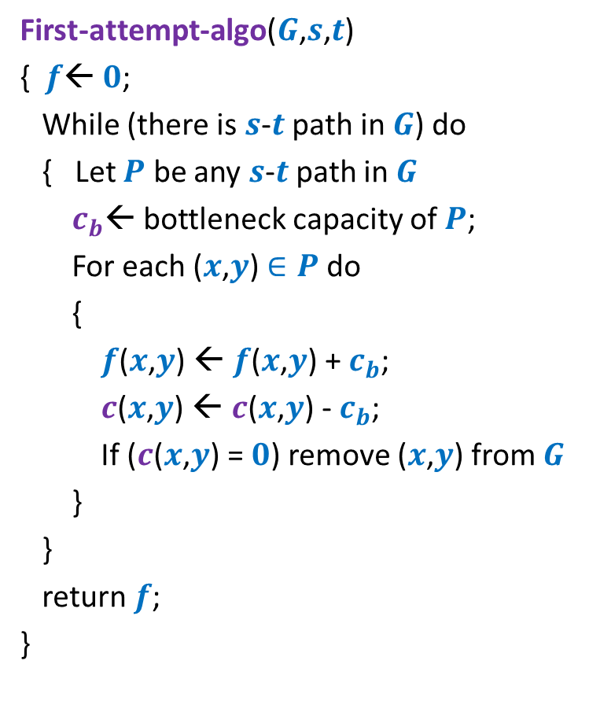
Towards designing a max flow algorithm
First-attempt-algo($G$,$s$,$t$)
{ $f$← $0$;
While (there is $s$-$t$ path in $G$) do
{ Let $P$ be any $s$-$t$ path in $G$
$c_{b}$← bottleneck capacity of $P$;
For each ($x$,$y$) $∈P$ do
{
$f$($x$,$y$) ← $f$($x$,$y$) + $c_{b}$;
$c$($x$,$y$) ← $c$($x$,$y$) - $c_{b}$;
If ($c$($x$,$y$) = $0$) remove ($x$,$y$) from $G$
}
}
return $f$;
}
Is the algorithm correct ?

Slide 8
A counterexample for First-attempt-algo

Slide 9

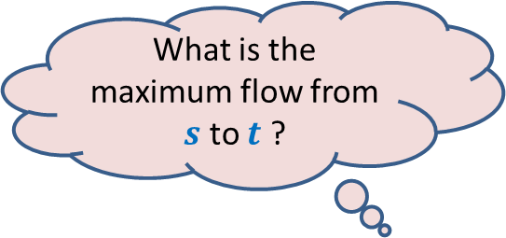



$$x$$
What is the maximum flow from $s$ to $t$ ?
20
10
20
10
$$s$$
10
50
$$t$$
30
10
20
10
20
$$y$$

Slide 10




Executing our first attempt algorithm
$$x$$
$$x$$
20
20
10
10
$$s$$
20
50
$$t$$
$$s$$
30
$$t$$
20
10
20
10
$$y$$
$$y$$
Maximum Capacity Path
Shortest Path ?
Minimum Capacity Path ?
No $s−t$ path

Slide 11
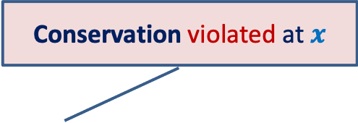

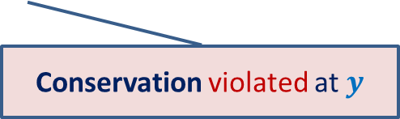
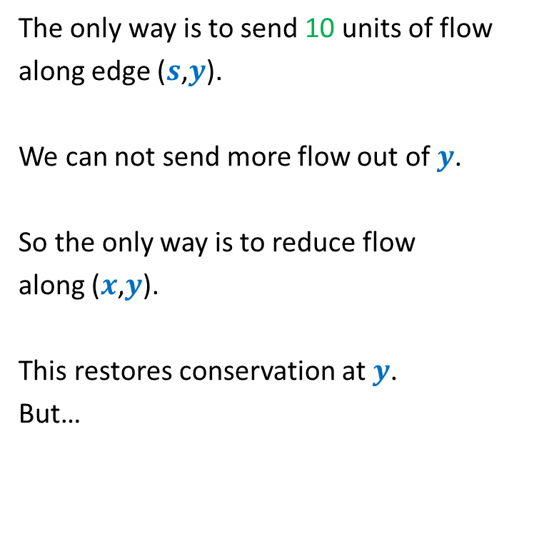


Finding a solution with scientific spirit
Conservation violated at $x$
The only way is to send 10 units of flow
along edge ($s$,$y$).
We can not send more flow out of $y$.
So the only way is to reduce flow
along ($x$,$y$).
This restores conservation at $y$.
But…
$$x$$
20
20
10
How to send extra 10 units of flow from $s$to $t$ ?
$$s$$
20
50
$$t$$
10
10
20
10
20
$$y$$
Conservation violated at $y$

Slide 12
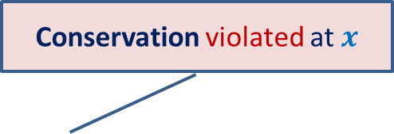

Finding a solution with scientific spirit
Conservation violated at $x$
$x$has excess incoming flow.
We can not reduce flow along ($s$,$x$).
But we can increase flow along ($x$,$t$) ☺.
$$x$$
20
10
20
10
$$s$$
10
50
$$t$$
10
20
10
20
$$y$$

Slide 13



Insights gained from the example
$$x$$
$$x$$
20
10
20
20
10
20
10
$$s$$
10
50
$$t$$
$$s$$
20
50
$$t$$
10
20
20
10
20
10
20
$$y$$
$$y$$
But how did we arrive at this redistribution ?
Let us look carefully.
Redistribution of flow at $x$ helped sending more flow from $s$ to $t$.

Slide 14


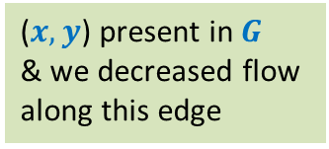




Insights gained from the example
$$x$$
We traversed a virtual path
20
10
20
10
($s,y$)
Present in $G$
We increased flow
along this edge
$$s$$
10
$$t$$
20
50
($x,y$) present in $G$
& we decreased flow
along this edge
($y,x$)
Not present in $G$
10
20
10
20
($x,t$)
Present in $G$
We increased flow
along this edge
$$y$$
Can you think of the key insight ? Spend some time before going to the next slide.

Slide 15












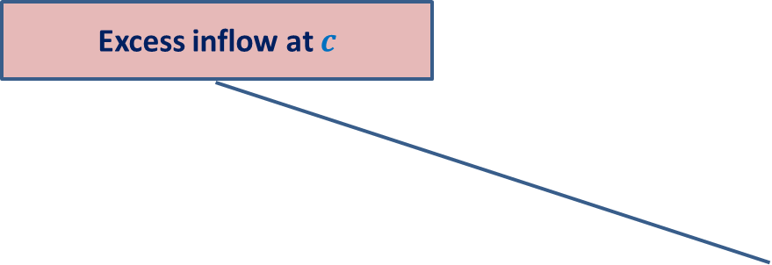

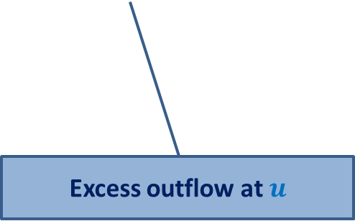

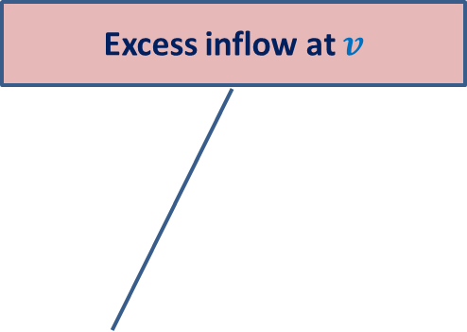
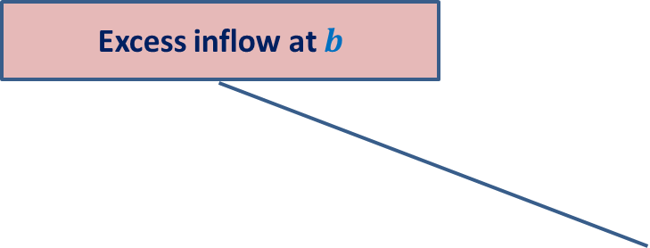





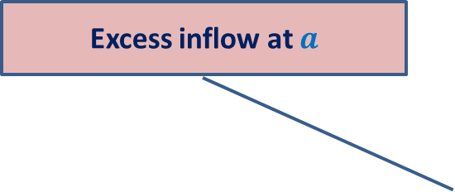
Consider any flow $f$
Excess inflow at $c$
Excess inflow at $y$
Excess inflow at $b$
Excess inflow at $x$
Excess inflow at $v$
Excess inflow at $a$
$$a$$
$$−Δ$$
$$−Δ$$
$$b$$
$$+Δ$$
$$c$$
$$+Δ$$
$$+Δ$$
$$v$$
$$x$$
$$y$$
$$s$$
$$+Δ$$
$$t$$
$$u$$
How to use this insight for sending more flow from source to sink ?
Think for a few minutes before moving further.
Excess outflow at $u$
$$G$$

Slide 16







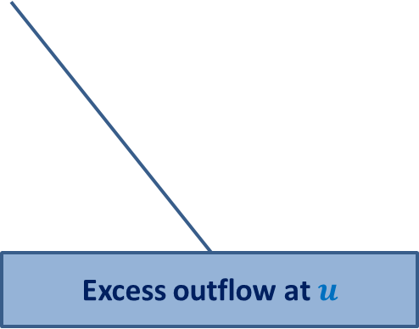
Consider any flow $f$
Excess inflow at $c$
$$a$$
$$−Δ$$
$$−Δ$$
$$b$$
$$+Δ$$
$$c$$
$$+Δ$$
$$+Δ$$
$$v$$
$$x$$
$$y$$
$$s$$
$$+Δ$$
$$t$$
$$u$$
Excess outflow at $u$
$$s$$
$$G$$

Slide 17
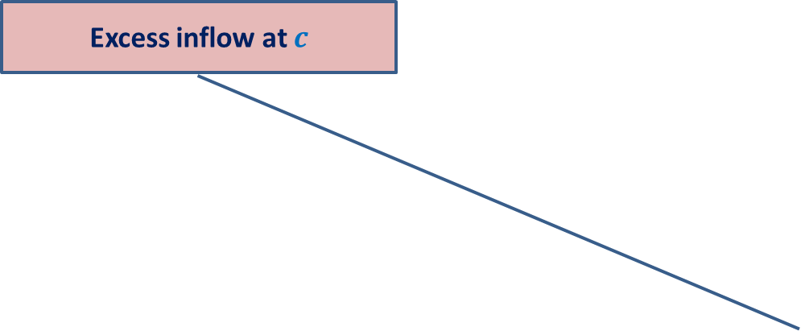


Consider any flow $f$
Excess inflow at $c$
$$t$$
$$a$$
$$−Δ$$
$$−Δ$$
$$b$$
$$+Δ$$
$$+Δ$$
$$+Δ$$
$$v$$
$$x$$
$$y$$
$$c$$
$$s$$
$$+Δ$$
$$t$$
$$u$$
Think for a while about the structure that will facilitate finding such a `virtual’ path from source to sink, if exists.
$$G$$

Slide 18

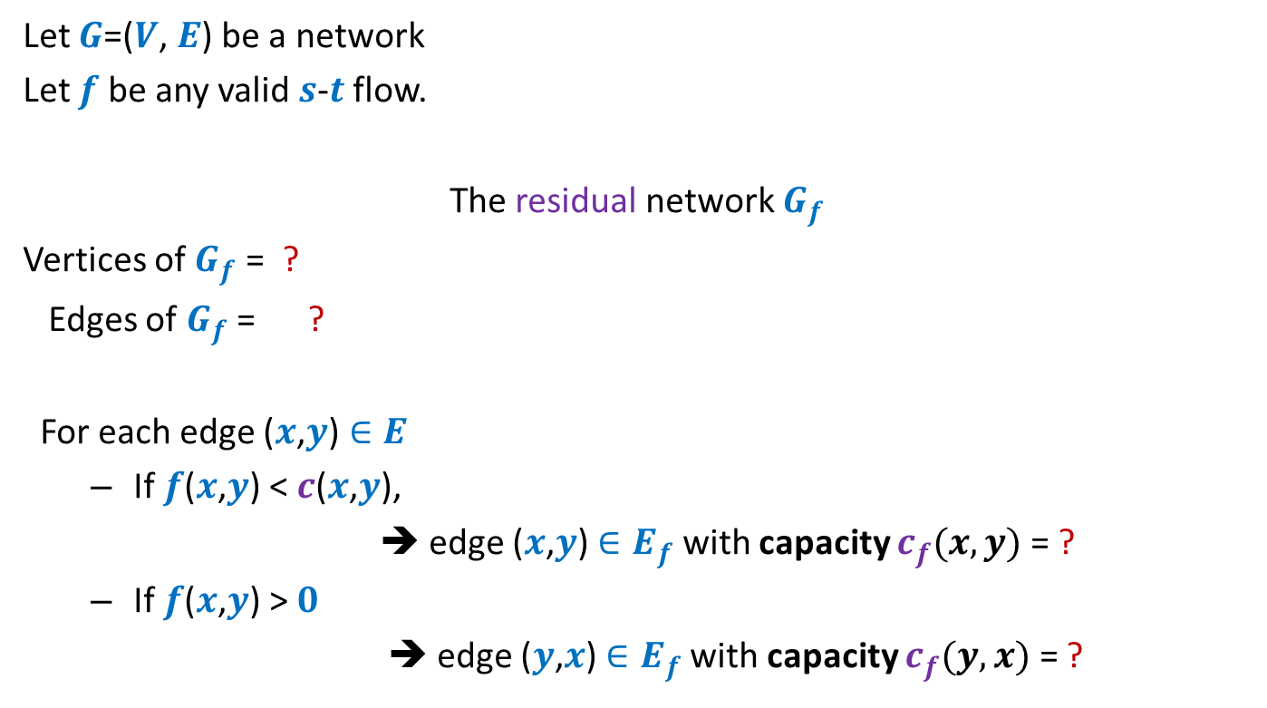



Residual network
Let $G$=($V$, $E$) be a network
Let $f$ be any valid $s$-$t$ flow.
The residual network $G_{f}$
Vertices of $G_{f}$ = ?
Edges of $G_{f}$ = ?
For each edge ($x$,$y$) $∈E$
If $f$($x$,$y$) < $c$($x$,$y$),
➔ edge ($x$,$y$) $∈E_{f}$ with capacity $c_{f}(x,y)$= ?
If $f$($x$,$y$) > $0$
➔ edge ($y$,$x$) $∈E_{f}$with capacity $c_{f}(y,x)$ = ?
$$V$$
$$E_{f}$$
Forward edge
$c$($x$,$y$) - $f$($x$,$y$)
Backward edge
$f$($x$,$y$)

Slide 19


Example of Residual Network
$$G$$
$$G_{f}$$
$$x$$
$$x$$
20
20
20
10
10
$$s$$
20
50
$$t$$
$$s$$
30
20
$$t$$
20
10
20
10
20
$$y$$
$$y$$

Slide 20
Example of Residual Network
$$G$$
$$G_{f}$$
$$x$$
$$x$$
20
20
10
20
10
10
$$s$$
20
50
$$t$$
$$s$$
30
20
$$t$$
10
10
20
10
20
10
20
$$y$$
$$y$$

Slide 21

Example of Residual Network
$$G$$
$$G_{f}$$
$$x$$
$$x$$
20
20
10
20
10
10
$$s$$
10
50
$$t$$
$$s$$
40
10
$$t$$
10
20
10
20
10
20
$$y$$
$$y$$
No $s−t$ path exists in $G_{f}$.

Slide 22










A generic step of increasing flow
Find a $s−t$ path $P$in $G_{f}$;
If edge ($x$, $y$) on the path is a forward edge
➔ Increase flow along ($x$, $y$) by $c′$ in $G$.
$$s$$
$$t$$
$$x$$
$$y$$
$$G$$
$$≥c′$$
$$≥c′$$
$$≥c′$$
$$s$$
$$t$$
$$x$$
$$y$$
$$P$$
$$G_{f}$$

Slide 23

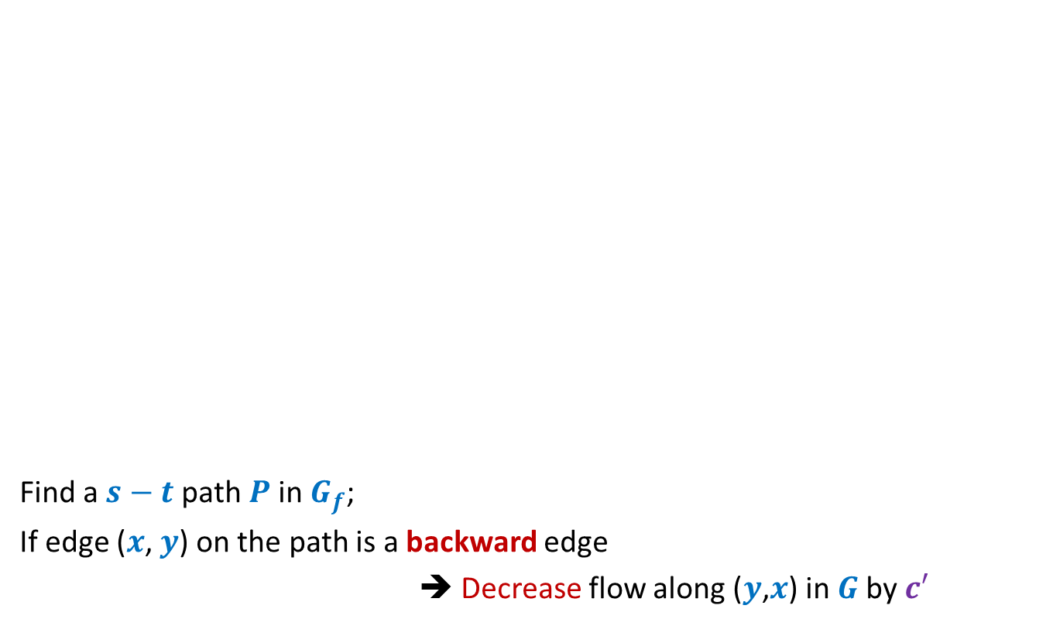
A generic step of increasing flow
Find a $s−t$ path $P$in $G_{f}$;
If edge ($x$, $y$) on the path is a backward edge
➔ Decrease flow along ($y$,$x$) in $G$by $c′$
$$s$$
$$t$$
$$x$$
$$y$$
$$G$$
This reduction of flow along ($y$,$x$) is a part of redistribution: we divert a part of $f$($y$,$x$) along some other outgoing edge of $y$, and increase flow along some edge entering $x$. Recall our example or slides 15-17.
$$≥c′$$
$$≥c′$$
$$≥c′$$
$$s$$
$$t$$
$$x$$
$$y$$
$$P$$
$$G_{f}$$

Slide 24
Ford Fulkerson algorithm
A simple path based algorithm
+
Residual Network

Slide 25

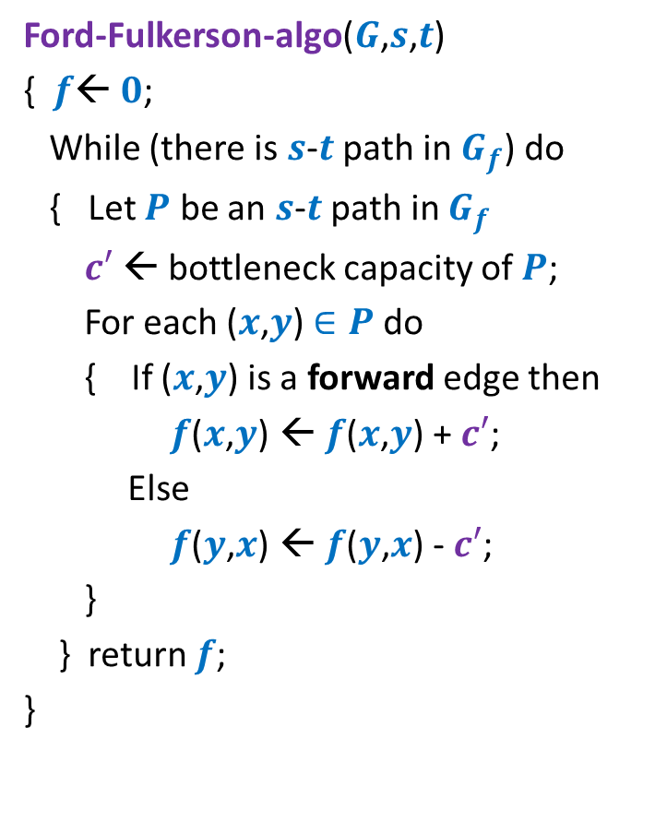
Ford Fulkerson algorithm
Ford-Fulkerson-algo($G$,$s$,$t$)
{ $f$← $0$;
While (there is $s$-$t$ path in $G_{f}$) do
{ Let $P$ be an $s$-$t$ path in $G_{f}$
$c′$ ← bottleneck capacity of $P$;
For each ($x$,$y$) $∈P$ do
{ If ($x$,$y$) is a forward edge then
$f$($x$,$y$) ← $f$($x$,$y$) + $c′$;
Else
$f$($y$,$x$) ← $f$($y$,$x$) - $c′$;
}
} return $f$;
}
Note that the flow changes in each iteration and so $G_{f}$ also changes. However, for the sake of compactness, we have not shown the code for updation of $G_{f}$.
As a homework, write the code for the same.

Slide 26









Ford Fulkerson algorithm
Ford-Fulkerson-algo($G$,$s$,$t$)
{ $f$← $0$;
While (there is $s$-$t$ path in $G_{f}$) do
{ Let $P$ be an $s$-$t$ path in $G_{f}$
$c′$ ← bottleneck capacity of $P$;
For each ($x$,$y$) $∈P$ do
{ If ($x$,$y$) is a forward edge then
$f$($x$,$y$) ← $f$($x$,$y$) + $c′$;
Else
$f$($y$,$x$) ← $f$($y$,$x$) - $c′$;
}
} return $f$;
}
Question:
Does the algorithm compute a valid flow ?
Capacity constraint is satisfied
Conservation ?
$$x∈P$$
$$G$$
$$u$$
$$x$$
$$y$$
$$G_{f}$$
$$u$$
$$x$$
$$y$$

Slide 27





Ford Fulkerson algorithm
Ford-Fulkerson-algo($G$,$s$,$t$)
{ $f$← $0$;
While (there is $s$-$t$ path in $G_{f}$) do
{ Let $P$ be an $s$-$t$ path in $G_{f}$
$c′$ ← bottleneck capacity of $P$;
For each ($x$,$y$) $∈P$ do
{ If ($x$,$y$) is a forward edge then
$f$($x$,$y$) ← $f$($x$,$y$) + $c′$;
Else
$f$($y$,$x$) ← $f$($y$,$x$) - $c′$;
}
} return $f$;
}
Question:
Does the algorithm compute a valid flow ?
Capacity constraint is satisfied
Conservation ?
$$x∈P$$
$$G$$
$$u$$
$$x$$
$$y$$
$$G_{f}$$
$$u$$
$$x$$
$$y$$

Slide 28
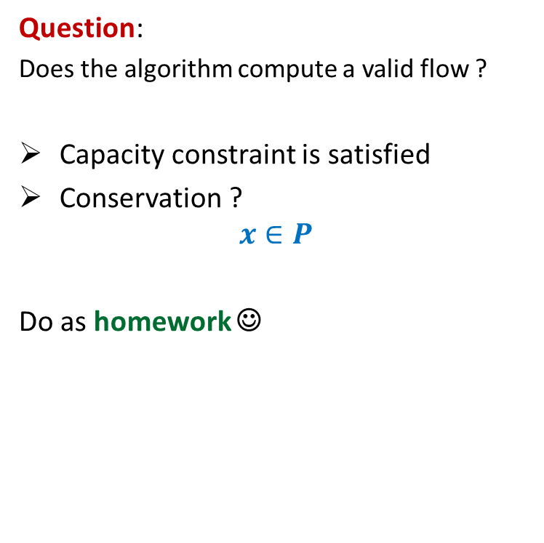
Ford Fulkerson algorithm
Ford-Fulkerson-algo($G$,$s$,$t$)
{ $f$← $0$;
While (there is $s$-$t$ path in $G_{f}$) do
{ Let $P$ be an $s$-$t$ path in $G_{f}$
$c′$ ← bottleneck capacity of $P$;
For each ($x$,$y$) $∈P$ do
{ If ($x$,$y$) is a forward edge then
$f$($x$,$y$) ← $f$($x$,$y$) + $c′$;
Else
$f$($y$,$x$) ← $f$($y$,$x$) - $c′$;
}
} return $f$;
}
Question:
Does the algorithm compute a valid flow ?
Capacity constraint is satisfied
Conservation ?
$$x∈P$$
Do as homework ☺
$$G_{f}$$
$$u$$
$$x$$
$$y$$
$$G_{f}$$
$$u$$
$$x$$
$$y$$

Slide 29
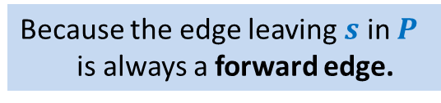
Ford Fulkerson algorithm
Ford-Fulkerson-algo($G$,$s$,$t$)
{ $f$← $0$;
While (there is $s$-$t$ path in $G_{f}$) do
{ Let $P$ be an $s$-$t$ path in $G_{f}$
$c′$ ← bottleneck capacity of $P$;
For each ($x$,$y$) $∈P$ do
{ If ($x$,$y$) is a forward edge then
$f$($x$,$y$) ← $f$($x$,$y$) + $c′$;
Else
$f$($y$,$x$) ← $f$($y$,$x$) - $c′$;
}
} return $f$;
}
Does the value of flow increase in every iteration ?
Yes.
Because the edge leaving $s$ in $P$
is always a forward edge.
Correctness of the algorithm ?

Slide 30
A useful exercise to internalize Ford Fulkerson algorithm
Execute Ford Fulkersion algorithm on this example when
The first path selected for sending the flow is <$s$, $x$, $v$, $t$>.
Show the execution of the iterations of the algorithm along with the residual network.
What if the first path selected is <$s$, $y$, $v$, $t$>.
Internalize the entire algorithm fully through this example.
$$x$$
10
3
9
5
$$s$$
$$t$$
8
$$u$$
10
$$v$$
10
3
3
6
5
$$y$$

Slide 31





Correctness ?
Suppose you find a flow of value $19$ using FF algorithm.
$$x$$
Is $19$ the max flow ?
10
3
9
14
$$s$$
$$t$$
$$≤27$$
8
$$u$$
2
$$v$$
10
$≤2$5
3
3
1
9
$$≤37$$
$$≤19$$
$$y$$

Slide 32
$s$-$t$Cuts

Slide 33


$s$-$t$cut
$A⊂V$, with
$s∈A$, $t∈\overline{A}$
$$s$$
$$t$$
$$A$$
$$\overline{A}$$
$$G$$

Slide 34
Cuts and Flows
Next Class ☺

